Slide 1
WEB API AND GIT INTRODUCTION
Ivana Zecevic, Ivana Sovilj
Novi Sad

Slide 2
Agenda
01
Introduction
02
Git basics
03
WEB Api – CQRS and Mediatr pattern
04
05
Postman
Questions

Slide 3
Task1:
1. Create a github account (If you don’t have it)
2. Fork a project Code9.Cinema from https://github.com/SoviljIvana/Code9
.Cinema/
3. Create a new branch feature/task1 from develop branch
4. Create Add/Update functions in CinemaRepository
5. Repository registration in Program.cs
6. Commit changes with corresponding commit message and push it
7. Create a merge request to merge feature/task1 into develop and merge it
8. Switch to develop branch and pull changes

Slide 4
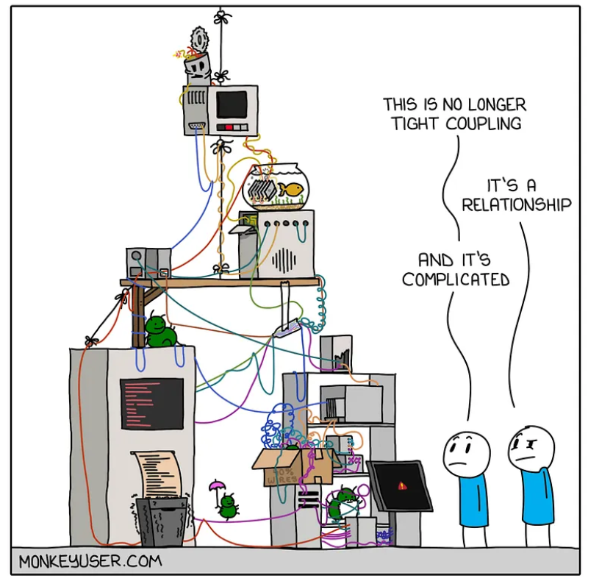

Slide 5
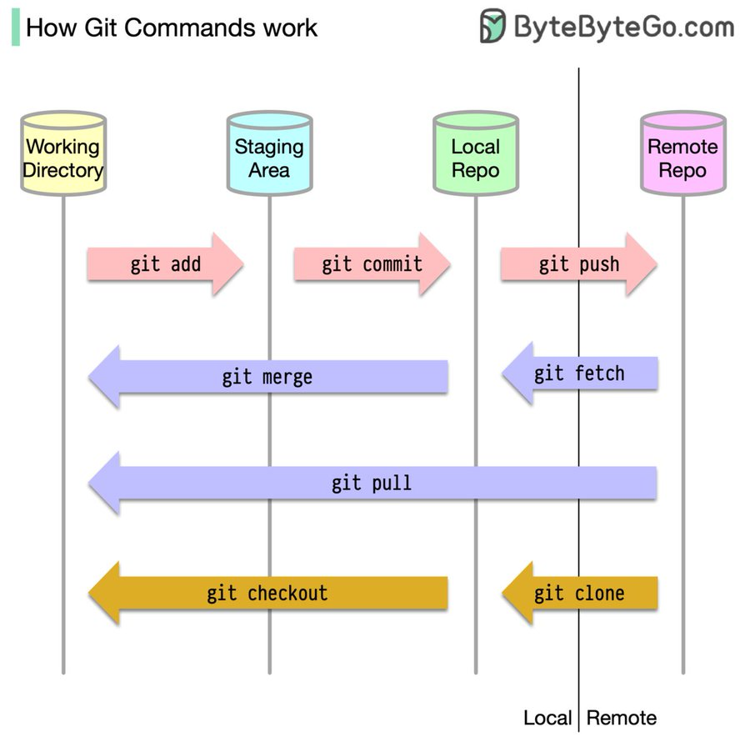
Git is a free and open source version control system.
Git is distributed: every developer has the full history of their code repository locally.
Git commands:
GIT FORK: create a copy of the original repository (upstream repository) but the repository remains on your GitHub account
GIT CLONE: clones the remote repository to your local machine
GIT COMMIT: save changes made to the files to a local repository
GIT PUSH: sends local commit to the remote repository
GIT PULL: get latest version of a repository
GIT MERGE: combines the changes from one branch to another branch
GIT CHECKOUT: navigate between branches
GIT FETCH: update your remote-tracking branches, this operation never changes your local branches
5

Slide 6
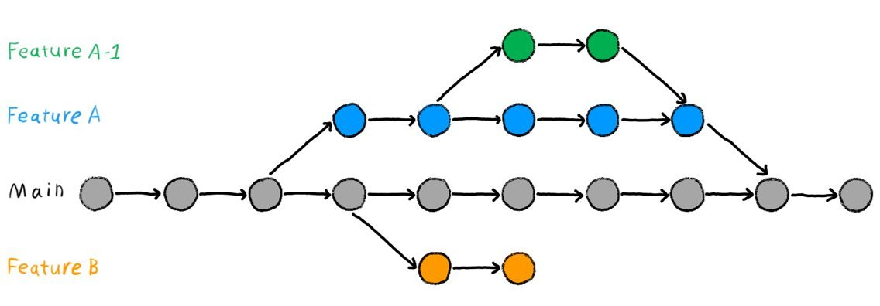

Git workflows:
Centralized
Feature branch
Gitflow
Oneflow
Forking
- Branches are used to develop features isolated from each other.
- The master/main branch is the "default" branch when you create a repository.
- Use other branches for development and merge them back to the master branch upon completion.
A feature branch is a copy of the main codebase where an individual or team of software developers can work on a new feature until it is complete.

Slide 7
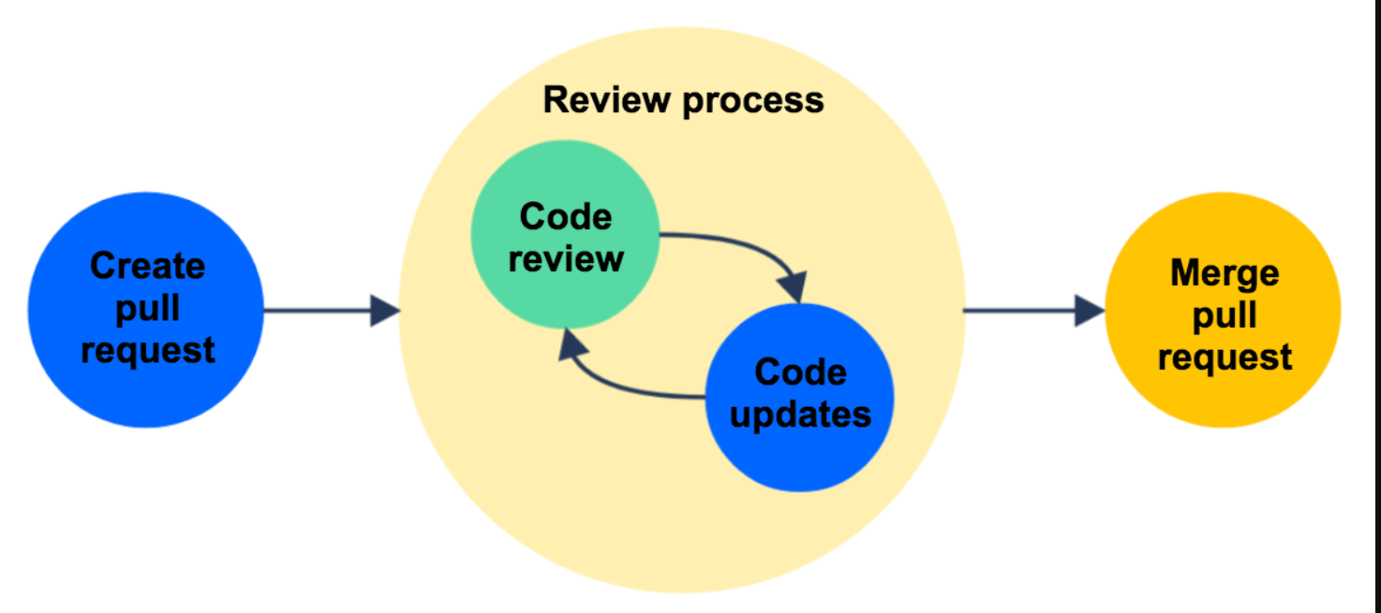
CODE REVIEW PROCESS

Slide 8
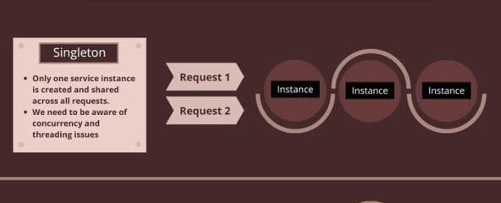

Slide 9
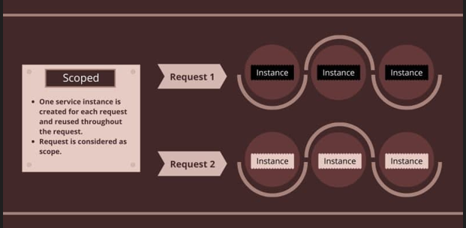

Slide 10
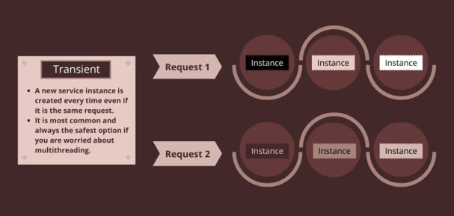

Slide 11
Task2:
1. Create a new branch feature/task2 from develop branch
2. Add new controller CinemaController into Controllers folder
and inject IMediator in controller (MediatR – NuGet Package)
*Let's open up Program.cs and register MediatR
3. Add necessary attributes: [ApiController] and Route("[controller]"),
*Controllers in a web API are classes that derive from ControllerBase
4. Add a new GET endpoint which will return a list of Cinemas

Slide 12
Task2:
5. Create a new folders into Domain:
-> Queries
-> Handlers
*create a query GetAllCinemasQuery (IRequest<response>)
*create a handler GetAllCinemasHandler (IRequestHandler<request, response>)
*GetAllCinemasHandler
- inject existing CinemaRepository and implement handler to get all cinemas from db
6. Run application and test it, also try same via Postman
7. Commit, push, create MR, merge, switch to develop and pull

Slide 13
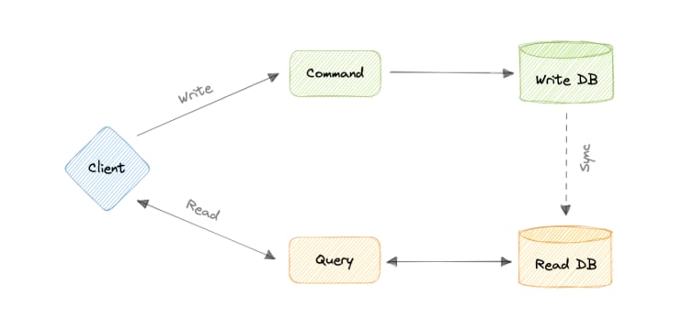
CQRS design PATTERN cOMMAND-QUERY responsibility segregation
13

Slide 14
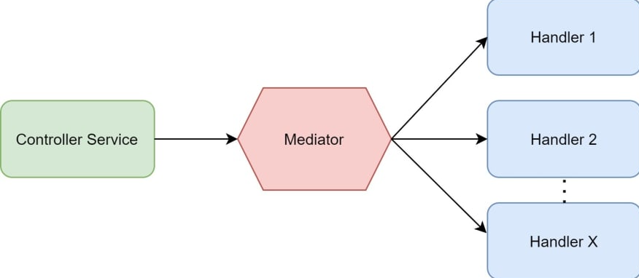
Mediator design pattern
14

Slide 15
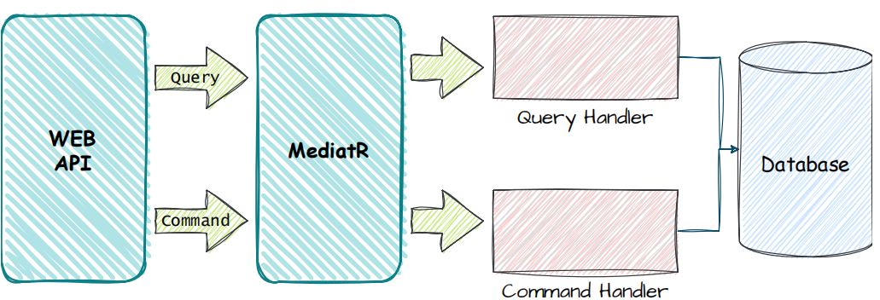
15

Slide 16
Task3:
1. Create a new branch feature/task3 from develop branch
2. Create a new folder into Domain:
-> Commands
2. Create a new folder into Code9WebApi:
-> Models
3. Add a new POST endpoint which will add new cinema
*create a new model for request: AddCinemaRequest
*create a command: AddCinemaCommand (IRequest<response>)
*create a handler: AddCinemaHandler (IRequestHandler<request, response>)
*AddCinemaHandler - inject existing CinemaRepository and implement handler
4. Run application and test it, also try same via Postman
5. Commit, push, create MR, merge, switch to develop and pull

Slide 17
Task4:
1. Create a new branch feature/task4 from develop branch and add new flow for UpdateCinema by ID
Task5:
1. Create a new branch feature/task5 from develop branch and add new flow for DeleteCinema by ID
Task6:
1. Create a new branch feature/task6 from develop branch and create GetById function in CinemaRepository

Slide 18

Questions

Slide 19
Thank you
Novi sad, Serbia
Levi9 Global Sourcing Balkan d.o.o.

